Slide 1
Multiplying and Dividing Real Numbers
Unit 1 Lesson 6

Slide 2
MULTIPLYING AND DIVIDING REAL NUMBERS
Students will be able to:
multiply and divide integers and rational numbers.
Key Vocabulary:
Division Rule
The quotient

Slide 3
MULTIPLYING AND DIVIDING REAL NUMBERS
MULTIPLYING REAL NUMBERS
The product of two real numbers with the same sign is positive.
The product of two real numbers with different signs is negative.
$$−a⋅\left(−b\right)=ab$$
$$a⋅\left(−b\right)=−ab$$

Slide 4
MULTIPLYING AND DIVIDING REAL NUMBERS
Sample Problem 1: Find the product.
a. | $$−4\left(6\right)$$ | b. | $$\left(−21\right)\left(−3\right)$$ | c. | $$11\left(−7\right)$$

Slide 5
MULTIPLYING AND DIVIDING REAL NUMBERS
Sample Problem 1: Find the product.
a. | $$−4\left(6\right)$$ | b. | $$\left(−21\right)\left(−3\right)$$ | c. | $$11\left(−7\right)$$
 | $$=−24$$ |  | $$=63$$ |  | $$=−77$$

Slide 6
MULTIPLYING AND DIVIDING REAL NUMBERS
Sample Problem 2: Simplify each expression.
a. | $$3\left(−4x\right)−15x$$ | b. | $$3s\left(−8r\right)$$ | c. | $$\left(8x\right)\left(−9y\right)−12xy$$

Slide 7
MULTIPLYING AND DIVIDING REAL NUMBERS
Sample Problem 2: Simplify each expression.
a. | $$3\left(−4x\right)−15x$$ | b. | $$3s\left(−8r\right)$$ | c. | $$\left(8x\right)\left(−9y\right)−12xy$$
 | $$=−12x−15x$$ |  | $$=−24sr$$ |  | $$=−72xy−12xy$$
 | $$=−27x$$ |  |  |  | $$=−84xy$$

Slide 8

MULTIPLYING AND DIVIDING REAL NUMBERS
Sample Problem 3: Evaluate each expression if $n=\frac{2}{5}$.
a. | $$n^{2}\left(−\frac{5}{8}\right)$$ | b. | $$5n$$ | c. | $$15n+6$$

Slide 9
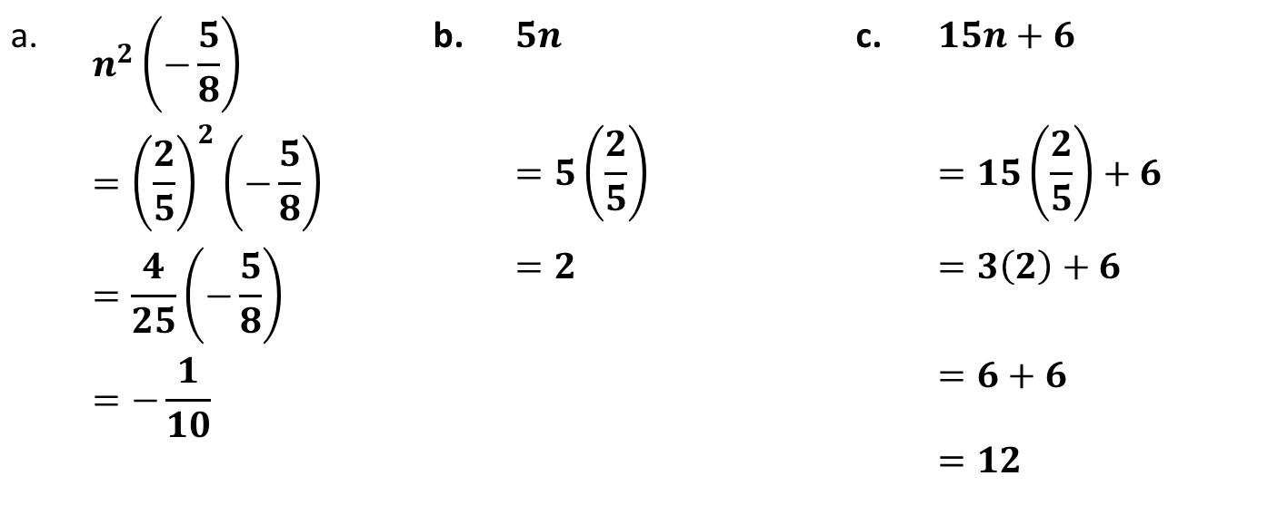
MULTIPLYING AND DIVIDING REAL NUMBERS
Sample Problem 3: Evaluate each expression if $n=\frac{2}{5}$.
a. | $$n^{2}\left(−\frac{5}{8}\right)$$ | b. | $$5n$$ | c. | $$15n+6$$
 | $$={\left(\frac{2}{5}\right)}^{2}\left(−\frac{5}{8}\right)$$ |  | $$=5\left(\frac{2}{5}\right)$$ |  | $$=15\left(\frac{2}{5}\right)+6$$
 | $$=\frac{4}{25}\left(−\frac{5}{8}\right)$$ |  | $$=2$$ |  | $$=3\left(2\right)+6$$
 | $$=−\frac{1}{10}$$ |  |  |  | $$=6+6$$
 |  |  |  |  | $$=12$$

Slide 10
MULTIPLYING AND DIVIDING REAL NUMBERS
Sample Problem 4: An average person need to drink 3 liters of water a day. How many liters of water an average person drinks in a month?

Slide 11
MULTIPLYING AND DIVIDING REAL NUMBERS
Sample Problem 4: An average person need to drink 3 liters of water a day. How many liters of water an average person drinks in a month?
$$3\left(30\right)=90 liters$$

Slide 12

MULTIPLYING AND DIVIDING REAL NUMBERS
DIVISION RULE
To divide a number $a$ by a nonzero number $b$, multiply $a$ by the reciprocal of $b$.
The result is the quotient of $a$ and $b$.
$$a÷b=a⋅\frac{1}{b}$$

Slide 13
MULTIPLYING AND DIVIDING REAL NUMBERS
Sample Problem 5: Find the quotient.
a. | $$−66÷11$$ | b. | $$\frac{48}{−3}$$ | c. | $$\frac{1}{3/4}$$

Slide 14
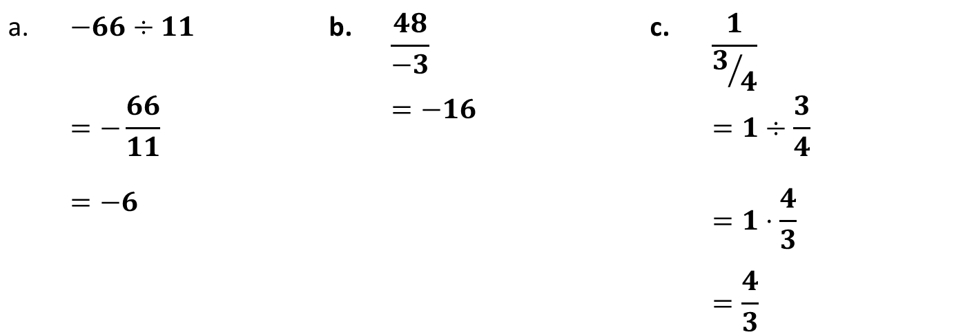
MULTIPLYING AND DIVIDING REAL NUMBERS
Sample Problem 5: Find the quotient.
a. | $$−66÷11$$ | b. | $$\frac{48}{−3}$$ | c. | $$\frac{1}{3/4}$$
 | $$=−\frac{66}{11}$$ |  | $$=−16$$ |  | $$=1÷\frac{3}{4}$$
 | $$=−6$$ |  |  |  | $$=1⋅\frac{4}{3}$$
 |  |  |  |  | $$=\frac{4}{3}$$

Slide 15


MULTIPLYING AND DIVIDING REAL NUMBERS
THE SIGN OF A QUOTIENT
The quotient of two numbers with the same sign is positive.
The quotient of two numbers with opposite signs is negative.
$$−a÷\left(−b\right)=\frac{a}{b}$$
$$a÷\left(−b\right)=−\frac{a}{b}$$

Slide 16
MULTIPLYING AND DIVIDING REAL NUMBERS
Sample Problem 6: Find the quotient.
a. | $$\frac{24−8x}{4}$$ | b. | $$\frac{32x−8}{4}$$ | c. | $$\frac{45+10x}{5}$$

Slide 17
MULTIPLYING AND DIVIDING REAL NUMBERS
Sample Problem 6: Simplify each expression.
a. | $$\frac{24−8x}{4}$$ | b. | $$\frac{32x−8}{4}$$ | c. | $$\frac{45+10x}{5}$$
 | $$=\frac{24}{4}−\frac{8x}{4}$$ |  | $$=\frac{32x}{4}−\frac{8}{4}$$ |  | $$=\frac{45}{5}+\frac{10x}{5}$$
 | $$=6−2x$$ |  | $$=8x−2$$ |  | $$=9+2x$$

Slide 18

MULTIPLYING AND DIVIDING REAL NUMBERS
Sample Problem 7: Evaluate each expression if $a=−3$ and $b=−2$.
a. | $$\frac{2a}{a−b}$$ | b. | $$\frac{4−b}{a^{2}}$$ | c. | $$\frac{a}{3−b}$$

Slide 19
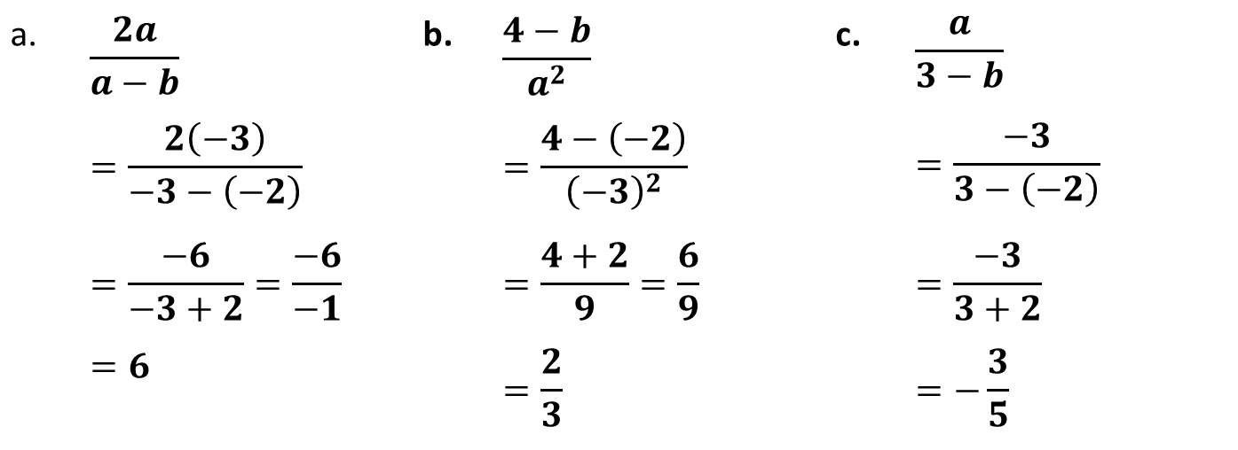
MULTIPLYING AND DIVIDING REAL NUMBERS
Sample Problem 7: Evaluate each expression if $a=−3$ and $b=−2$.
a. | $$\frac{2a}{a−b}$$ | b. | $$\frac{4−b}{a^{2}}$$ | c. | $$\frac{a}{3−b}$$
 | $$=\frac{2\left(−3\right)}{−3−\left(−2\right)}$$ |  | $$=\frac{4−\left(−2\right)}{{\left(−3\right)}^{2}}$$ |  | $$=\frac{−3}{3−\left(−2\right)}$$
 | $$=\frac{−6}{−3+2}=\frac{−6}{−1}$$ |  | $$=\frac{4+2}{9}=\frac{6}{9}$$ |  | $$=\frac{−3}{3+2}$$
 | $$=6$$ |  | $$=\frac{2}{3}$$ |  | $$=−\frac{3}{5}$$

Slide 20
MULTIPLYING AND DIVIDING REAL NUMBERS
Sample Problem 8: Russia has a land area of $17,098,242 km^{2}$ Russia is approximately seven times bigger than Algeria in terms of land area. What is the land area of Algeria?

Slide 21
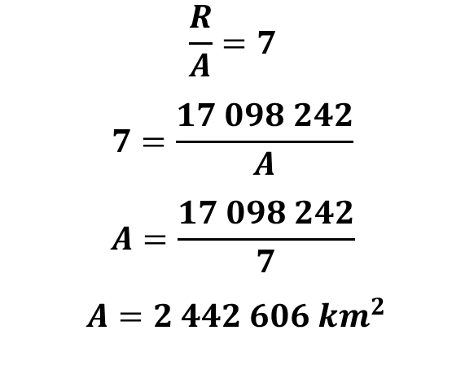
MULTIPLYING AND DIVIDING REAL NUMBERS
Sample Problem 8: Russia has a land area of $17,098,242 km^{2}$ Russia is approximately seven times bigger than Algeria in terms of land area. What is the land area of Algeria?
$$\frac{R}{A}=7$$
$$7=\frac{17 098 242}{A}$$
$$A=\frac{17 098 242}{7}$$
$$A=2 442 606 km^{2}$$

