Slide 1
The Distributive Property
Unit 1 Lesson 7

Slide 2
THE DISTRIBUTIVE PROPERTY
Students will be able to:
use the distributive property, and
simplify expressions by combining like terms.
Key Vocabulary:
Term • Coefficient
Like Terms • Simplest Form

Slide 3
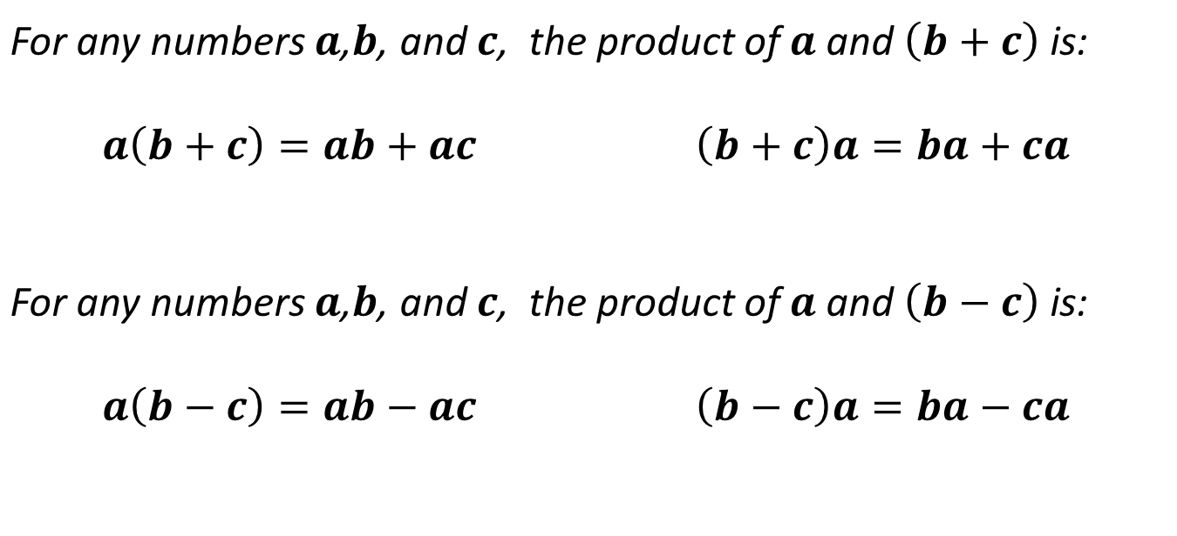
THE DISTRIBUTIVE PROPERTY
DISTRIBUTIVE PROPERTY
For any numbers $a$,$b$, and $c$, the product of $a$ and $\left(b+c\right)$ is:
$$a\left(b+c\right)=ab+ac$$ | $$\left(b+c\right)a=ba+ca$$
For any numbers $a$,$b$, and $c$, the product of $a$ and $\left(b−c\right)$ is:
$$a\left(b−c\right)=ab−ac$$ | $$\left(b−c\right)a=ba−ca$$

Slide 4
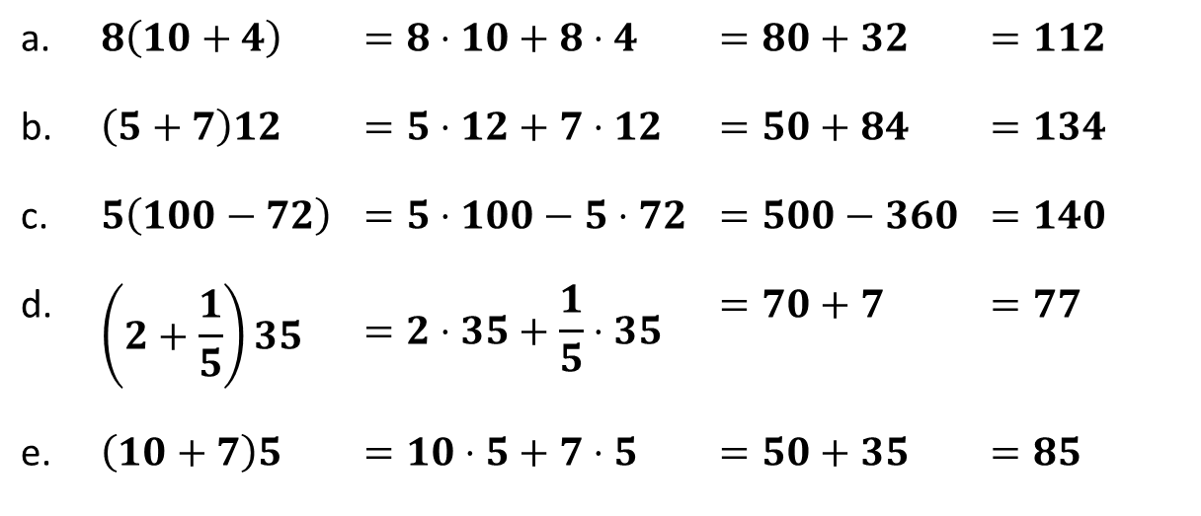
THE DISTRIBUTIVE PROPERTY
Sample Problem 1: Rewrite using the distributive property, then evaluate.
a. | $$8\left(10+4\right)$$ | $$=8⋅10+8⋅4$$ | $$=80+32$$ | $$=112$$
b. | $$\left(5+7\right)12$$ | $$=5⋅12+7⋅12$$ | $$=50+84$$ | $$=134$$
c. | $$5\left(100−72\right)$$ | $$=5⋅100−5⋅72$$ | $$=500−360$$ | $$=140$$
d. | $$\left(2+\frac{1}{5}\right)35$$ | $$=2⋅35+\frac{1}{5}⋅35$$ | $$=70+7$$ | $$=77$$
e. | $$\left(10+7\right)5$$ | $$=10⋅5+7⋅5$$ | $$=50+35$$ | $$=85$$

Slide 5
THE DISTRIBUTIVE PROPERTY
TERM is a number, a variable or a product or quotient of numbers and variables.
LIKE TERMS are terms that contain the same variables, with corresponding variables having the same power.
SIMPLIFYING EXPRESSIONS:
Distributive property is used to combine like terms by adding their coefficients. A simplified expression must not have grouping symbols and fractions are reduced to its lowest term.

Slide 6
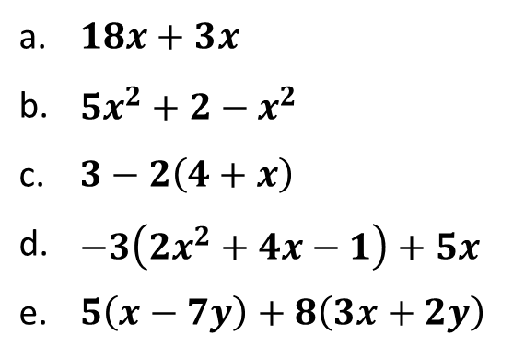
THE DISTRIBUTIVE PROPERTY
Sample Problem 2: Simplify.
a. | $18x+3$ $x$
b. | $5x^{2}+2−x^{2}$
c. | $3−2\left(4+x\right)$
d. | $−3\left(2x^{2}+4x−1\right)+5x$
e. | $5\left(x−7y\right)+8\left(3x+2y\right)$

Slide 7
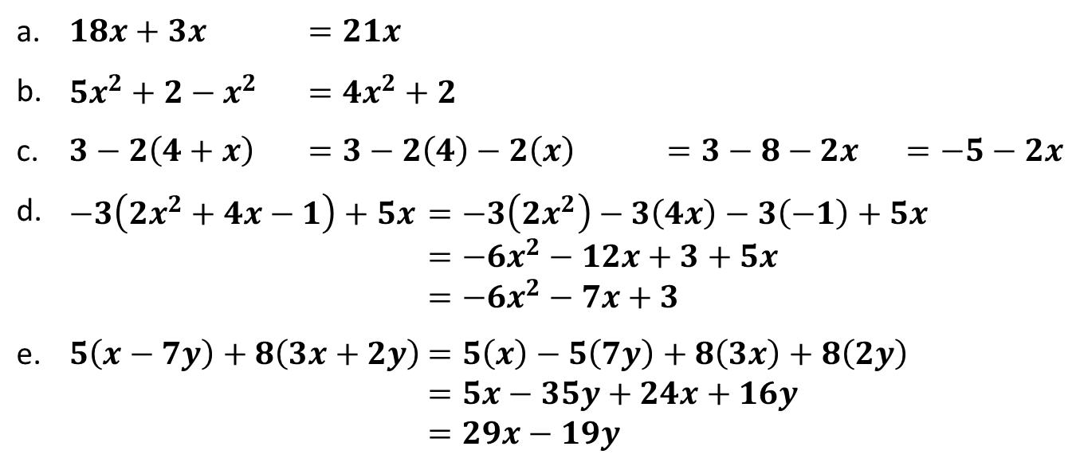
THE DISTRIBUTIVE PROPERTY
Sample Problem 2: Simplify.
a. | $18x+3x$ $=21x$
b. | $5x^{2}+2−x^{2}$ $=4x^{2}+2$
c. | $3−2\left(4+x\right)$ $=3−2\left(4\right)−2\left(x\right)$ $=3−8−2x$ $=−5−2x$
d. | $−3\left(2x^{2}+4x−1\right)+5x$ $=−3\left(2x^{2}\right)−3\left(4x\right)−3\left(−1\right)+5x$ $=−6x^{2}−12x+3+5x$ $=−6x^{2}−7x+3$
e. | $5\left(x−7y\right)+8\left(3x+2y\right)$ $=5\left(x\right)−5\left(7y\right)+8\left(3x\right)+8\left(2y\right)$ $=5x−35y+24x+16y$ $=29x−19y$

Slide 8
THE DISTRIBUTIVE PROPERTY
Sample Problem 3: Manny runs a restaurant. One day, a total of 50 steaks are sold. Each steak cost $14.95 and received an average tip of $1 for each. Write the expression that determines the total amount he earned. How much did Manny earned?

Slide 9
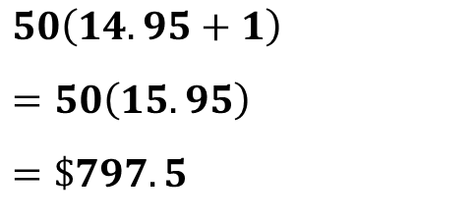
THE DISTRIBUTIVE PROPERTY
Sample Problem 3: Manny runs a restaurant. One day, a total of 50 steaks are sold. Each steak cost $14.95 and received an average tip of $1 for each. Write the expression that determines the total amount he earned. How much did Manny earned?
$$50\left(14.95+1\right)$$
$$=50\left(15.95\right)$$
$$=\$797.5$$

