Slide 1
The Real Number System
Unit 1 Lesson 1

Slide 2
THE REAL NUMBER SYSTEM
Students will be able to:
Classify the set of real numbers using their properties and characteristics.
Relate the concept of “opposites” in real-life situations.
Represent the real-life situations with integers.
Graph/Plot real numbers on a number line.
Differentiate positive integers form negative integers.
Graph/Plot integers on a number line.
Compare real numbers on a number line.
Arrange real numbers given a specific order.
Define absolute value.
Find the absolute value of real numbers.

Slide 3
THE REAL NUMBER SYSTEM
Key Vocabulary:
Real Number | Counting / Natural Number
Irrational Number | Positive Integers
Rational Number | Negative Integers
Non-Integer | Number Line
Integer | Opposites
Whole Number | Absolute Value

Slide 4
THE REAL NUMBER SYSTEM
THE SET OF REAL NUMBERS
When we were young, we were taught how to count using the set of counting numbers.
Little did we know that numbers too have different types. The tree diagram below shows the different types numbers and how each kind is related to one another.

Slide 5
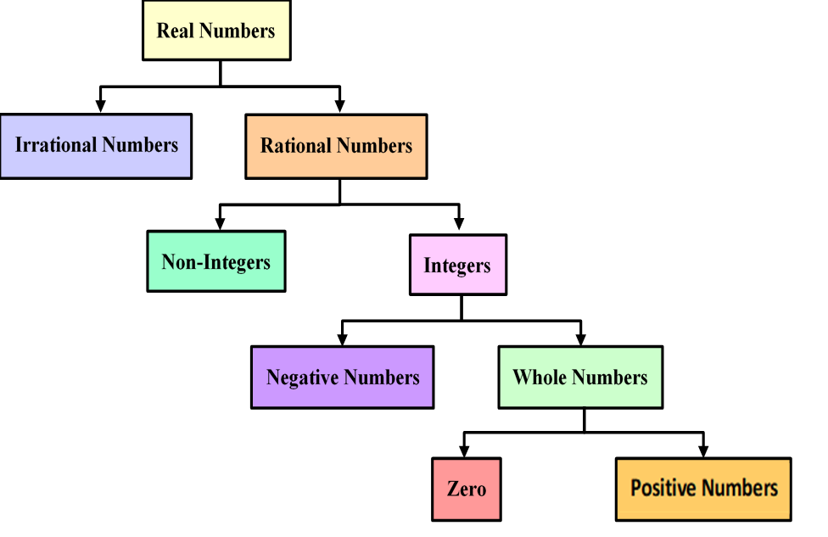
THE REAL NUMBER SYSTEM
THE SET OF REAL NUMBERS

Slide 6
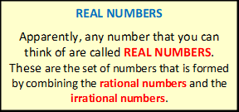
THE REAL NUMBER SYSTEM
THE SET OF REAL NUMBERS

Slide 7
THE REAL NUMBER SYSTEM
REAL NUMBERS can be IRRATIONAL or RATIONAL.

Slide 8
THE REAL NUMBER SYSTEM
REAL NUMBERS can be IRRATIONAL or RATIONAL.

Slide 9
THE REAL NUMBER SYSTEM
RATIONAL NUMBERS can be NON-INTEGERS or INTEGERS.

Slide 10
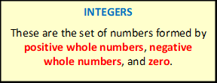
THE REAL NUMBER SYSTEM
RATIONAL NUMBERS can be NON-INTEGERS or INTEGERS.

Slide 11
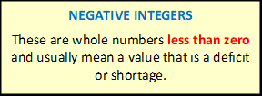
THE REAL NUMBER SYSTEM
INTEGERS can be NEGATIVE or WHOLE NUMBERS.

Slide 12
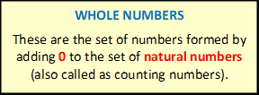
THE REAL NUMBER SYSTEM
INTEGERS can be NEGATIVE or WHOLE NUMBERS.

Slide 13
THE REAL NUMBER SYSTEM
WHOLE NUMBERS include ZERO and POSITIVE INTEGERS.

Slide 14
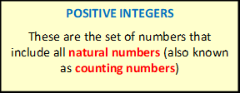
THE REAL NUMBER SYSTEM
WHOLE NUMBERS include ZERO and POSITIVE INTEGERS.

Slide 15
THE REAL NUMBER SYSTEM
Sample Problem 1: Look at the numbers inside the box and classify each according to the type of number described.

Slide 16
THE REAL NUMBER SYSTEM
Sample Problem 1: Look at the numbers inside the box and classify each according to the type of number described.

Slide 17
THE REAL NUMBER SYSTEM
Sample Problem 1: Look at the numbers inside the box and classify each according to the type of number described.

Slide 18
THE REAL NUMBER SYSTEM
Sample Problem 1: Look at the numbers inside the box and classify each according to the type of number described.

Slide 19
THE REAL NUMBER SYSTEM
Sample Problem 1: Look at the numbers inside the box and classify each according to the type of number described.

Slide 20
THE REAL NUMBER SYSTEM
Sample Problem 1: Look at the numbers inside the box and classify each according to the type of number described.

Slide 21
THE REAL NUMBER SYSTEM
Sample Problem 1: Look at the numbers inside the box and classify each according to the type of number described.

Slide 22
THE REAL NUMBER SYSTEM
Sample Problem 1: Look at the numbers inside the box and classify each according to the type of number described.

Slide 23
THE REAL NUMBER SYSTEM
Sample Problem 1: Solution

Slide 24
THE REAL NUMBER SYSTEM
Sample Problem 1: Solution

Slide 25
THE REAL NUMBER SYSTEM
Sample Problem 1: Solution

Slide 26
THE REAL NUMBER SYSTEM
Sample Problem 1: Solution

Slide 27
THE REAL NUMBER SYSTEM
Sample Problem 1: Solution

Slide 28
THE REAL NUMBER SYSTEM
Sample Problem 1: Solution

Slide 29
THE REAL NUMBER SYSTEM
Sample Problem 1: Solution

Slide 30
THE REAL NUMBER SYSTEM
Sample Problem 1: Solution

Slide 31
THE REAL NUMBER SYSTEM
REAL NUMBERS ON THE NUMBER LINE
A NUMBER LINE is a straight line with numbers written in equal intervals. It can be used to show the sets of real numbers composed of rational and irrational numbers. On a REAL NUMBER LINE:
There is a point that corresponds for every real number.
There is a real number for each point.

Slide 32
THE REAL NUMBER SYSTEM
OPPOSITES
The idea of opposites used in real-life can include, but are not limited to the following:

Slide 33
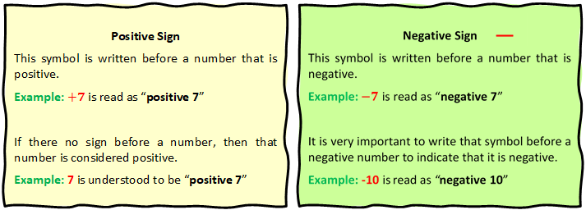
THE REAL NUMBER SYSTEM
OPPOSITES
In Mathematics, on the other hand, OPPPOSITES are denoted by the following signs:

Slide 34
THE REAL NUMBER SYSTEM
OPPOSITES
Also, ZERO IS NEITHER POSITIVE NOR NEGATIVE.

Slide 35
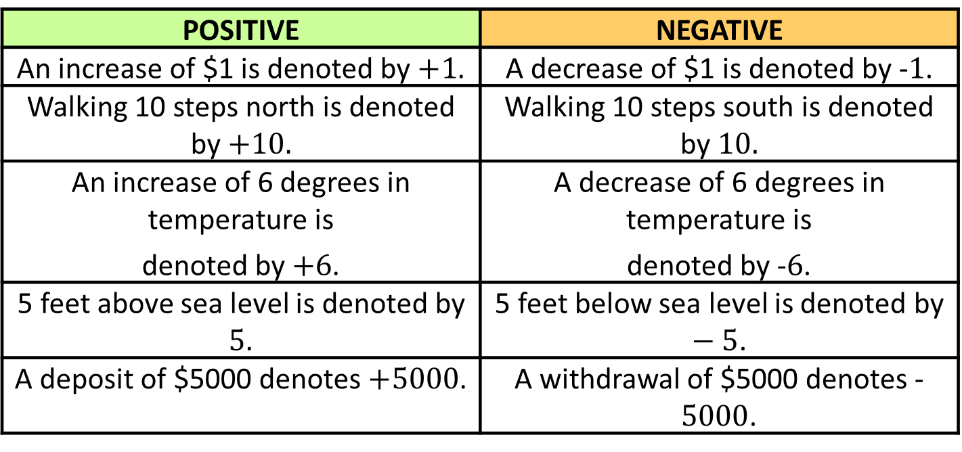
THE REAL NUMBER SYSTEM
REPRESENTATIONS OF OPPOSITES IN REAL LIFE
POSITIVE | NEGATIVE
An increase of $1 is denoted by $+1$. | A decrease of $1 is denoted by -$1$.
Walking 10 steps north is denoted by $+10.$ | Walking 10 steps south is denoted by $10.$
An increase of 6 degrees in temperature is denoted by $+6$. | A decrease of 6 degrees in temperature is denoted by -$6$.
5 feet above sea level is denoted by $5$. | 5 feet below sea level is denoted by $−5$.
A deposit of $5000 denotes $+5000$. | A withdrawal of $5000 denotes -$5000$.

Slide 36
THE REAL NUMBER SYSTEM
Sample Problem 2: Represent the following with integers.
a. | A weight loss of 7 kilograms
b. | Walking 10 blocks north
c. | 225 meters below sea level.
d. | Going up the stairs by 6 steps

Slide 37
THE REAL NUMBER SYSTEM
Sample Problem 2: Represent the following with integers.
e. | The temperature drops 5 degrees
f. | Losing 10 points in a game
g. | Moving a table 5 meters forward
h. | A debt of $10,000

Slide 38
THE REAL NUMBER SYSTEM
Sample Problem 2: Solution
a. | A weight loss of 7 kilograms
b. | Walking 10 blocks north
c. | 225 meters below sea level.
d. | Going up the stairs by 6 steps

Slide 39
THE REAL NUMBER SYSTEM
Sample Problem 2: Solution
e. | The temperature drops 5 degrees
f. | Losing 10 points in a game
g. | Moving a table 5 meters forward
h. | A debt of $10,000

Slide 40
THE REAL NUMBER SYSTEM
INTEGERS ON THE NUMBER LINE
Integers, composed of negative whole numbers, positive whole numbers and zero, can be graphed or plotted on a number line.
The starting point of a number line is at its origin, at ZERO.

Slide 41
THE REAL NUMBER SYSTEM
INTEGERS ON THE NUMBER LINE
POSITIVE INTEGERS on the number line are the integers that are found to the right of zero. As the number line extends to the right of zero, the integers increase.

Slide 42
THE REAL NUMBER SYSTEM
INTEGERS ON THE NUMBER LINE
NEGATIVE INTEGERS on the number line are the integers that are found to the left of zero. As the number line extends to the left of zero, the integers decrease.

Slide 43

THE REAL NUMBER SYSTEM
Sample Problem 3: Graph the real numbers $−1, 3, 0, 2, \frac{3}{4}, −\frac{1}{2}$ and $−2.6$ on the number line and write the numbers in increasing order.

Slide 44
THE REAL NUMBER SYSTEM
Sample Problem 3: Solution

Slide 45
THE REAL NUMBER SYSTEM
Sample Problem 4: Plot the integers $−4$ and $−6$ on the number line and write two inequalities, using the symbols > or <, that compare the two numbers.

Slide 46
THE REAL NUMBER SYSTEM
Sample Problem 4: Solution

Slide 47
THE REAL NUMBER SYSTEM
Sample Problem 5: Arrange the real numbers below in descending order.

Slide 48
THE REAL NUMBER SYSTEM
Sample Problem 5: Solution

Slide 49
THE REAL NUMBER SYSTEM
ABSOLUTE VALUE OF A REAL NUMBER
ABSOLUTE VALUE of a real number is the distance between the origin and the point representing the real number. The symbol$\left|x\right|$represents the absolute value of a number$x$.

Slide 50
THE REAL NUMBER SYSTEM
Sample Problem 6: Evaluate and graph the numbers $\left|2.5\right|$ and $\left|−\frac{1}{2}\right|$ on the number line.

Slide 51
THE REAL NUMBER SYSTEM
Sample Problem 6: Solution

Slide 52
THE REAL NUMBER SYSTEM
Sample Problem 7: Determine the value of each.
a. | $$\left|0.25\right|$$
b. | $$\left|−9\right|$$
c. | $$\left|−\frac{6}{5}\right|$$
d. | $$\left|−11\right|$$
e. | $$\left|32\right|$$

Slide 53
THE REAL NUMBER SYSTEM
Sample Problem 7: Solution
a. | $$\left|0.25\right|$$
b. | $$\left|−9\right|$$
c. | $$\left|−\frac{6}{5}\right|$$
d. | $$\left|−11\right|$$
e. | $$\left|32\right|$$

