Slide 1

Operation on Integers
Unit 1 Lesson 2

Slide 2
OPERATIONS ON INTEGERS
Students will be able to:
Add and subtract integers using the number line.
Perform operations on integers by applying the appropriate rules.

Slide 3
OPERATIONS ON INTEGERS
Key Vocabulary:
Integers
Number Line
Positive Integers
Negative Integer
Addition
Subtraction
Multiplication Division

Slide 4
OPERATIONS ON INTEGERS
OPERATIONS OF INTEGERS
Operations involving positive and negative integers (like the usual whole numbers that we know) also involve the four operations ADDITION, SUBTRACTION, MULTIPLICATION and DIVISION.
Operations on integers can be done using the number line, or numerically using different rules.

Slide 5
OPERATIONS ON INTEGERS
ADDITION AND SUBTRACTION OF INTEGERS USING THE NUMBER LINE
A number line is used as a visual model to show what happens when positive and negative numbers are added or subtracted.

Slide 6
OPERATIONS ON INTEGERS
THINGS TO REMEMBER IN ADDING OR SUBTRACTING INTEGERS USING THE NUMBER LINE:
The starting point is always at ZERO.
If the integer is positive the movement on the number line is always to the RIGHT.
If the integer is negative the movement on the number line is always to the LEFT.

Slide 7
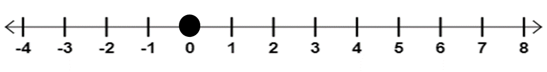
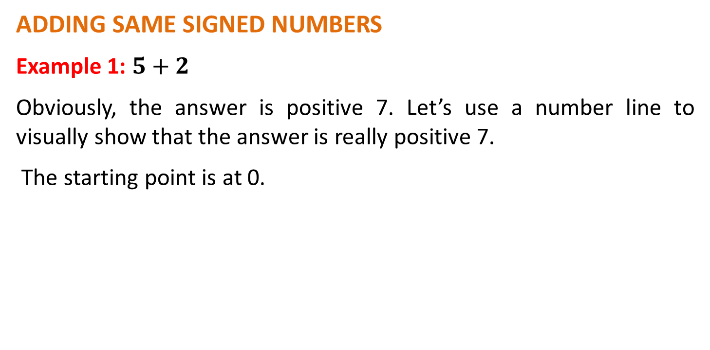
OPERATIONS ON INTEGERS
ADDING SAME SIGNED NUMBERS
Example 1: $5+2$
Obviously, the answer is positive 7. Let’s use a number line to visually show that the answer is really positive 7.
The starting point is at 0.

Slide 8

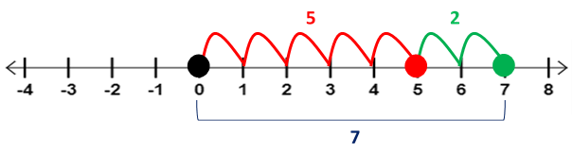
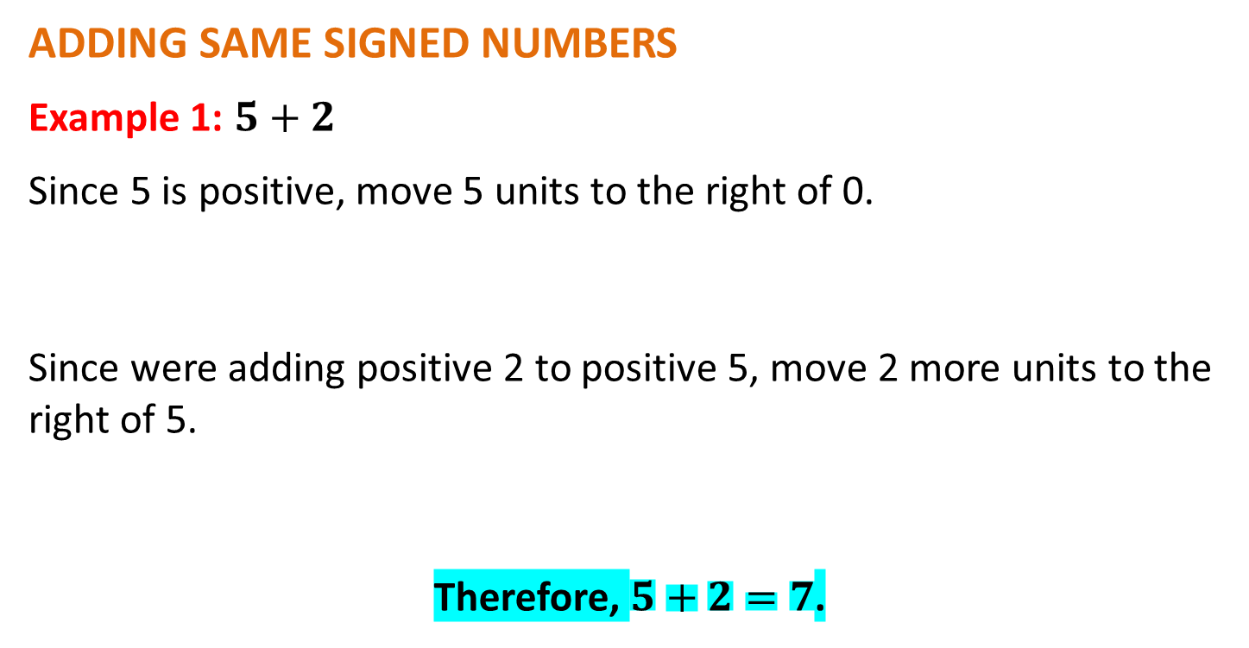
OPERATIONS ON INTEGERS
ADDING SAME SIGNED NUMBERS
Example 1: $5+2$
Since 5 is positive, move 5 units to the right of 0.
Since were adding positive 2 to positive 5, move 2 more units to the right of 5.
Therefore, $5+2=7$.

Slide 9
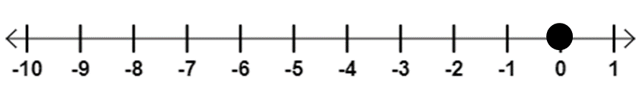
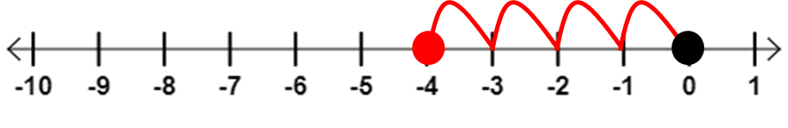
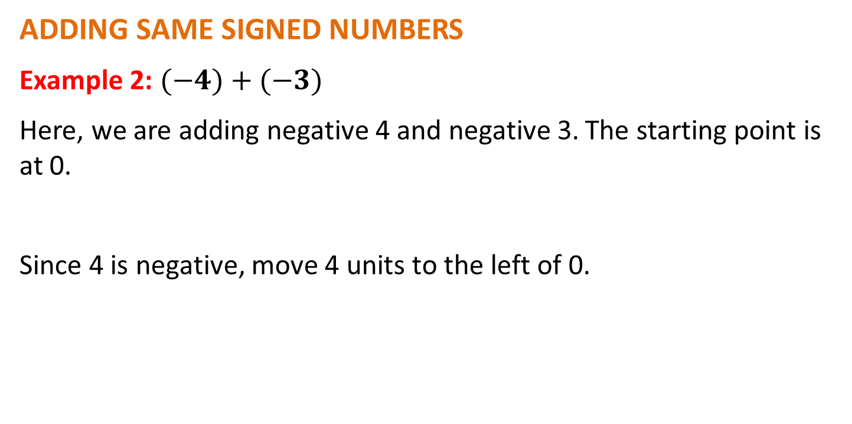
OPERATIONS ON INTEGERS
ADDING SAME SIGNED NUMBERS
Example 2: $(−4)+(−3)$
Here, we are adding negative 4 and negative 3. The starting point is at 0.
Since 4 is negative, move 4 units to the left of 0.

Slide 10
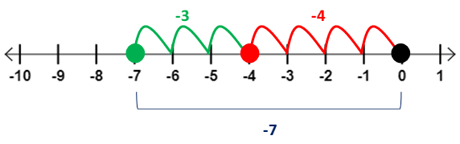
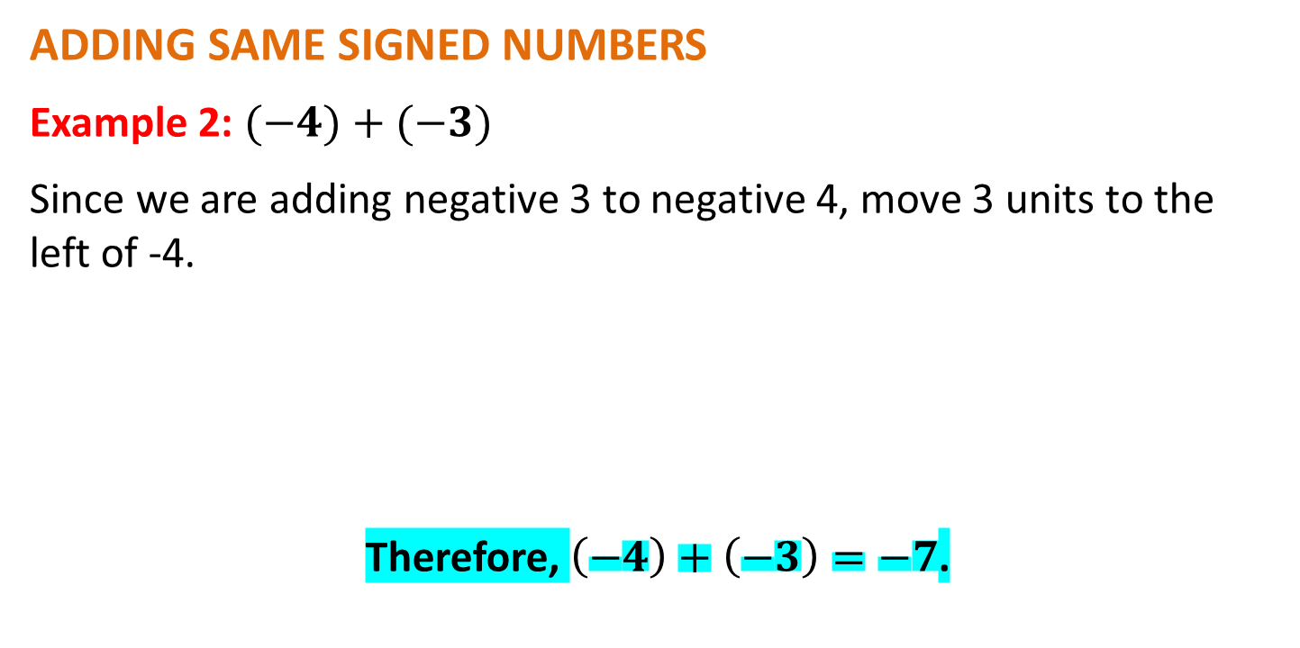
OPERATIONS ON INTEGERS
ADDING SAME SIGNED NUMBERS
Example 2: $(−4)+(−3)$
Since we are adding negative 3 to negative 4, move 3 units to the left of -4.
Therefore, $\left(−4\right)+\left(−3\right)=−7$.

Slide 11
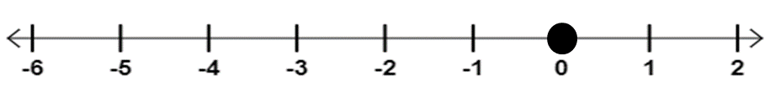
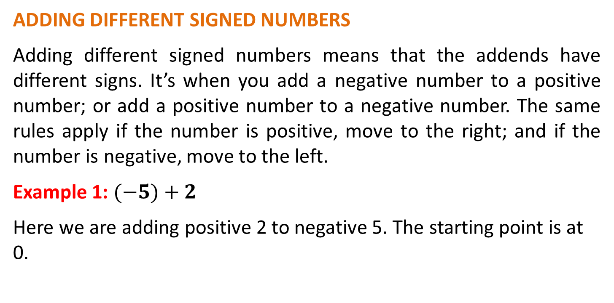
OPERATIONS ON INTEGERS
ADDING DIFFERENT SIGNED NUMBERS
Adding different signed numbers means that the addends have different signs. It’s when you add a negative number to a positive number; or add a positive number to a negative number. The same rules apply if the number is positive, move to the right; and if the number is negative, move to the left.
Example 1: $(−5)+2$
Here we are adding positive 2 to negative 5. The starting point is at 0.

Slide 12
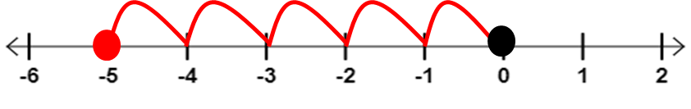
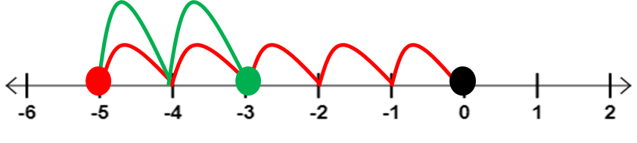
OPERATIONS ON INTEGERS
ADDING DIFFERENT SIGNED NUMBERS
Since 5 is negative, move 5 units to the left of 0.
Since we are adding positive 2 to negative 5, we move 2 units to the right of -5.

Slide 13
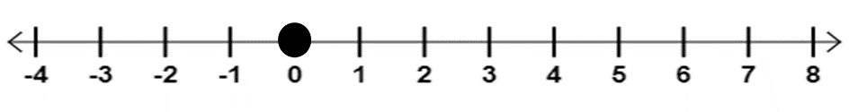
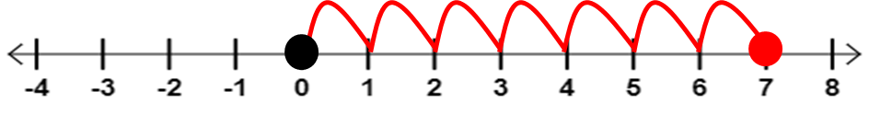
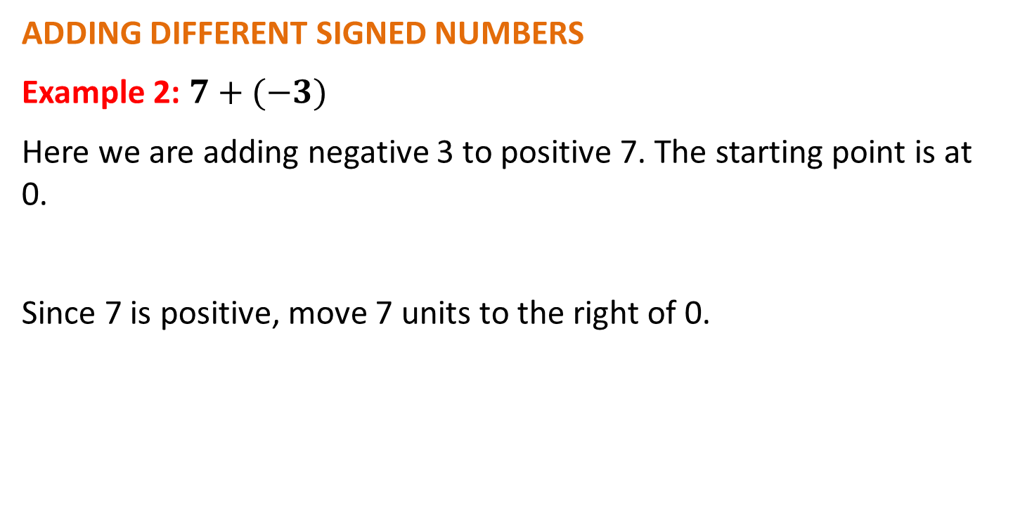
OPERATIONS ON INTEGERS
ADDING DIFFERENT SIGNED NUMBERS
Example 2: $7+(−3)$
Here we are adding negative 3 to positive 7. The starting point is at 0.
Since 7 is positive, move 7 units to the right of 0.

Slide 14
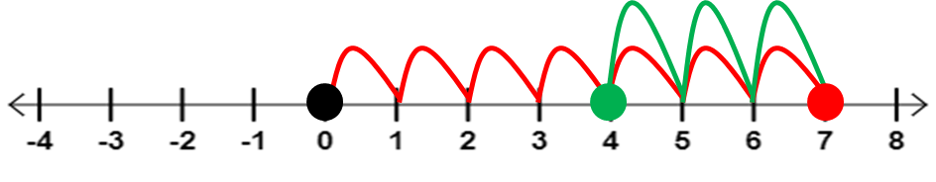
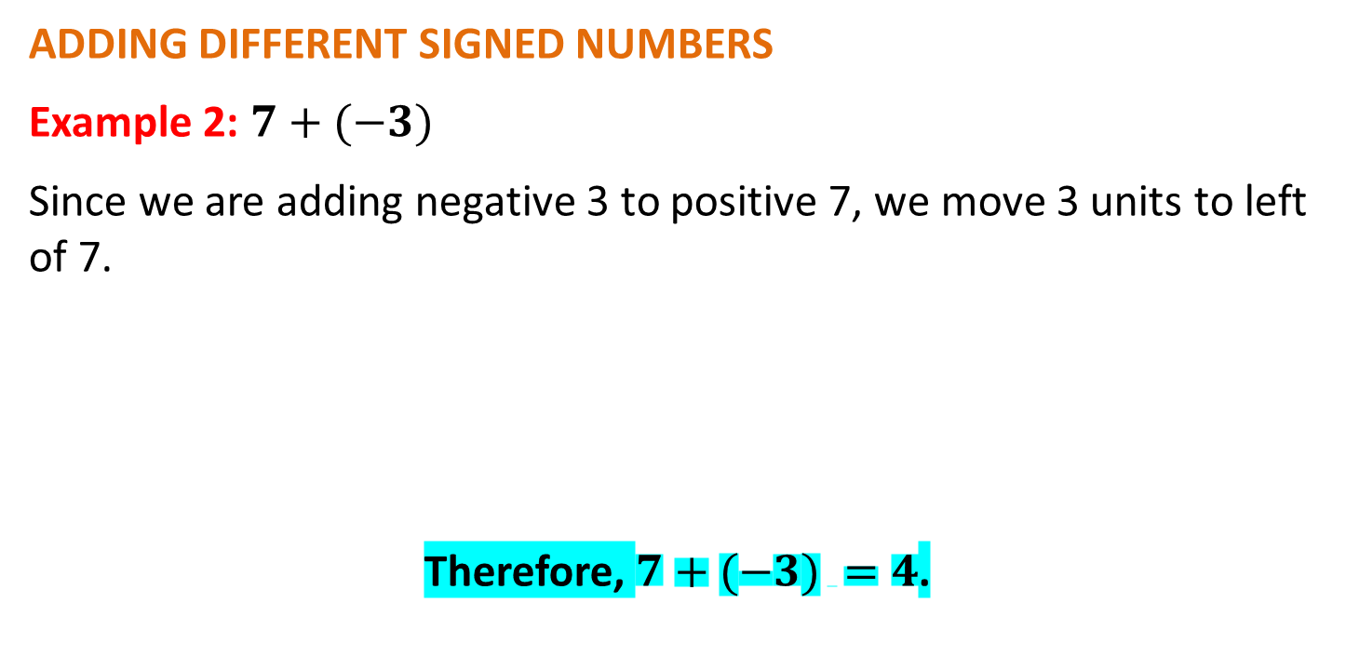
OPERATIONS ON INTEGERS
ADDING DIFFERENT SIGNED NUMBERS
Example 2: $7+(−3)$
Since we are adding negative 3 to positive 7, we move 3 units to left of 7.
Therefore, $7+(−3) =4$.

Slide 15
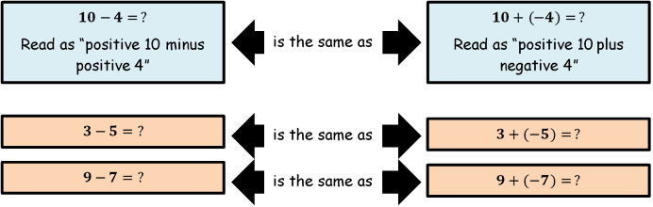
OPERATIONS ON INTEGERS
SUBTRACTING INTEGERS
Before subtracting integers using the number line, there is one very important RULE to remember.
“TO SUBTRACT IS TO ADD ITS OPPOSITE”

Slide 16
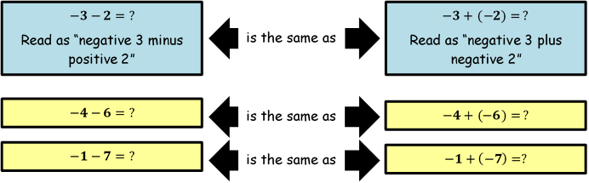
OPERATIONS ON INTEGERS
SUBTRACTING INTEGERS
Before subtracting integers using the number line, there is one very important RULE to remember.
“TO SUBTRACT IS TO ADD ITS OPPOSITE”

Slide 17

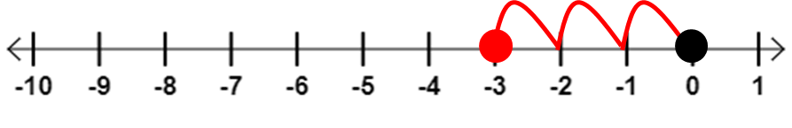
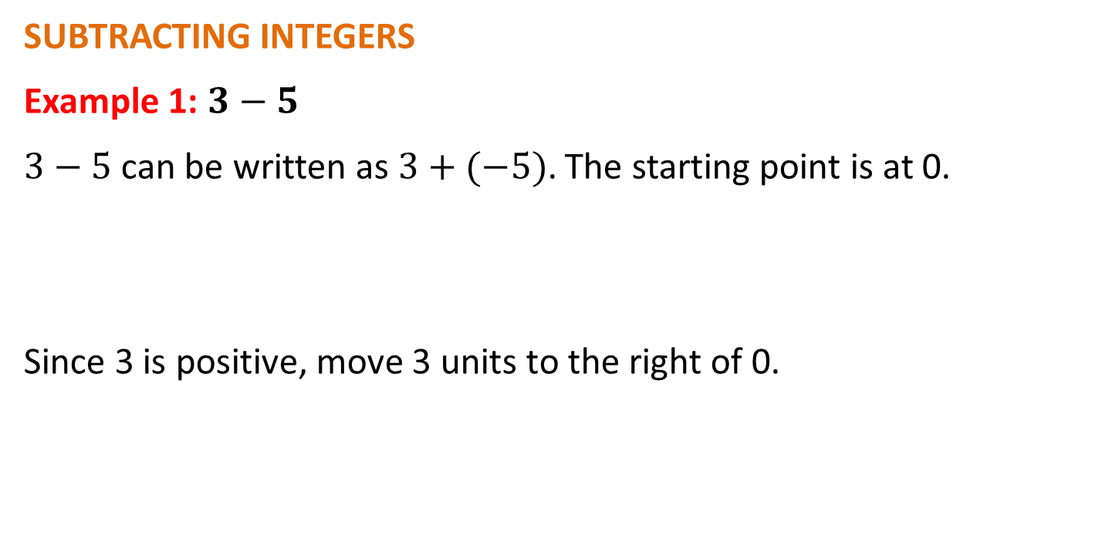
OPERATIONS ON INTEGERS
SUBTRACTING INTEGERS
Example 1: $3−5$
$3−5$ can be written as $3+(−5)$. The starting point is at 0.
Since 3 is positive, move 3 units to the right of 0.

Slide 18
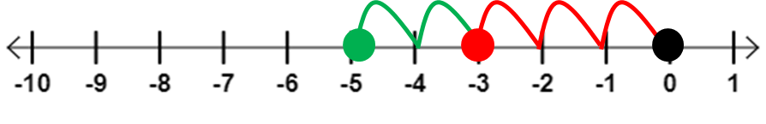
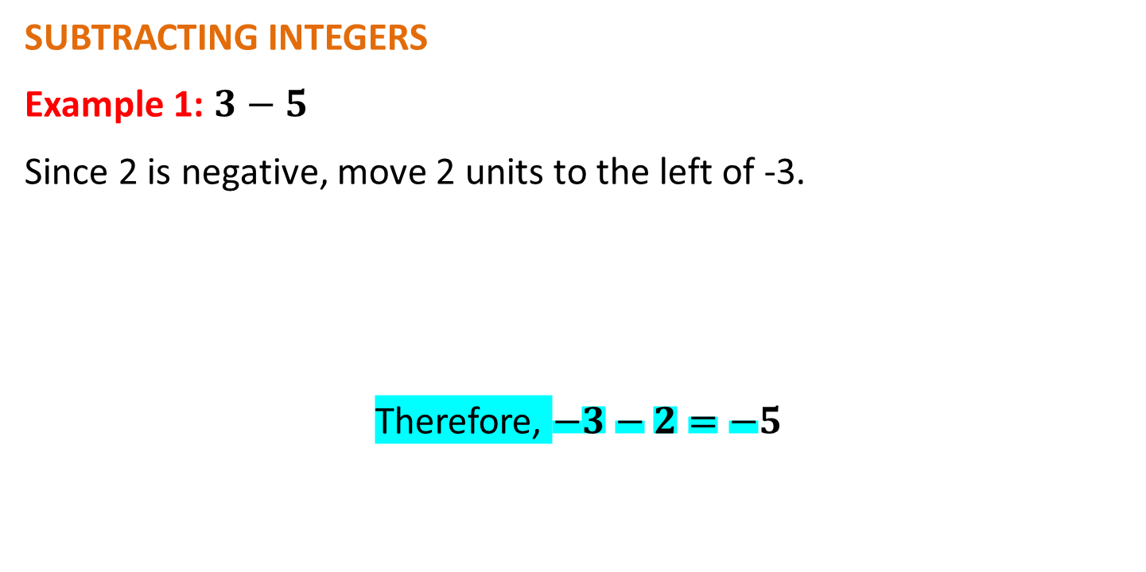
OPERATIONS ON INTEGERS
SUBTRACTING INTEGERS
Example 1: $3−5$
Since 2 is negative, move 2 units to the left of -3.
Therefore, $−3−2=−5$

Slide 19
OPERATIONS ON INTEGERS
Sample Problem 1: Perform the indicated operation using the number line.

Slide 20

OPERATIONS ON INTEGERS
Sample Problem 1: Solution

Slide 21
OPERATIONS ON INTEGERS
ADDING INTEGERS NUMERICALLY
Creating number lines to perform operations on integers can be a tedious task; but it is a nice way to visually show what happens to integers when they are added or subtracted.
To perform operations easier and simpler, we can also do this numerically, using a few sets of rules.

Slide 22
OPERATIONS ON INTEGERS
ADDING SAME SIGNED INTEGERS
RULE: Simply add the given numbers and then copy the sign of the addends.
Getting the sum of integers having the same signs is like doing a simple addition. Just add the numbers and copy the sign of the addends.

Slide 23
OPERATIONS ON INTEGERS
ADDING SAME SIGNED INTEGERS

Slide 24
OPERATIONS ON INTEGERS
ADDING SAME SIGNED INTEGERS
More Examples:

Slide 25
OPERATIONS ON INTEGERS
ADDING DIFFERENT SIGNED INTEGERS
This means that the addends have different signs.
To get the sum, follow this rule:
RULE: Subtract the absolute value of the smaller number from the absolute value of the larger number and then keep the sign of the number with the larger absolute value.

Slide 26
OPERATIONS ON INTEGERS
ADDING DIFFERENT SIGNED INTEGERS
RULE: Subtract the absolute value of the smaller number from the absolute value of the larger number and then keep the sign of the number with the larger absolute value.
The absolute value of a number is the distance of the number from zero, without any regard to its direction. So it is safe to say that the absolute value of any integer is always positive (because there is NO NEGATIVE DISTANCE).

Slide 27
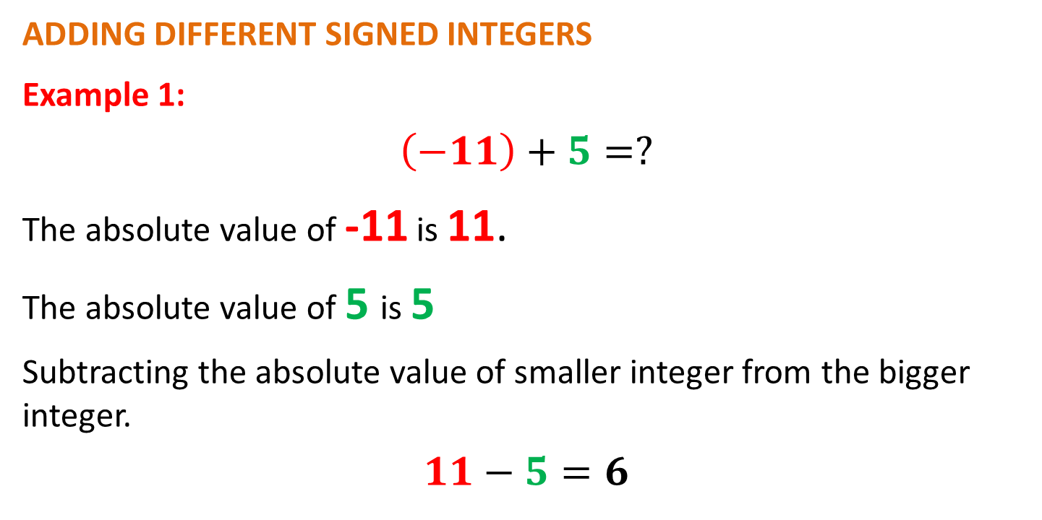
OPERATIONS ON INTEGERS
ADDING DIFFERENT SIGNED INTEGERS
Example 1:
$$\left(−11\right)+5=?$$
The absolute value of -11 is 11.
The absolute value of 5 is 5
Subtracting the absolute value of smaller integer from the bigger integer.
$$11−5=6$$

Slide 28
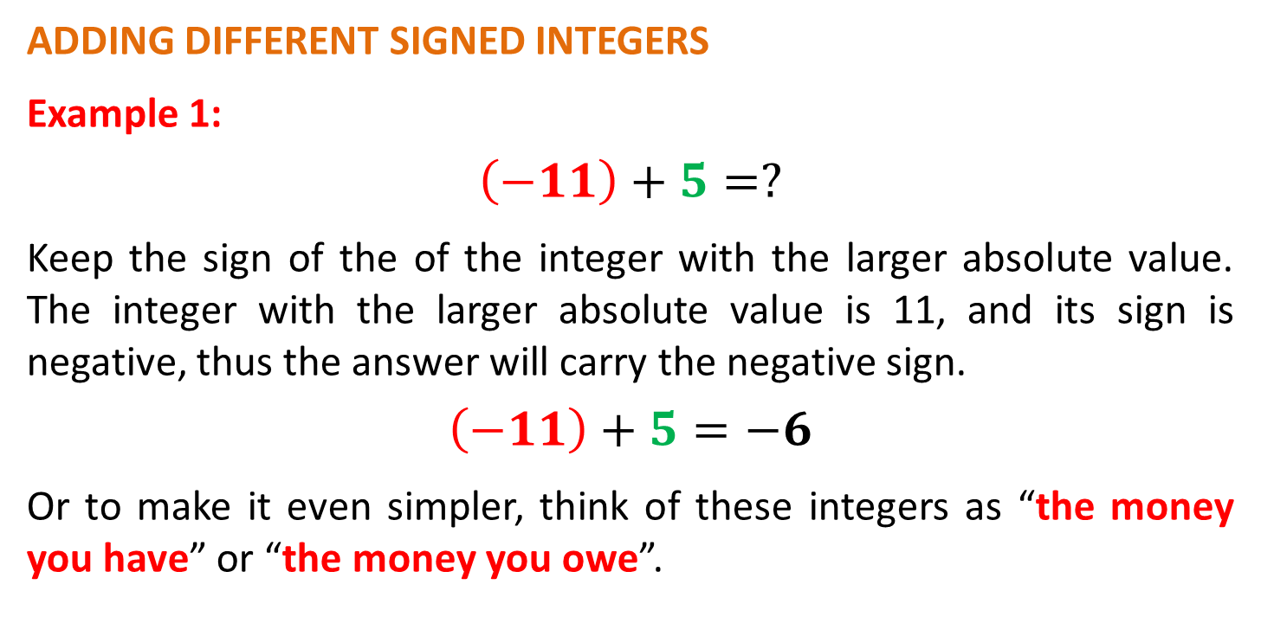
OPERATIONS ON INTEGERS
ADDING DIFFERENT SIGNED INTEGERS
Example 1:
$$\left(−11\right)+5=?$$
Keep the sign of the of the integer with the larger absolute value. The integer with the larger absolute value is 11, and its sign is negative, thus the answer will carry the negative sign.
$$\left(−11\right)+5=−6$$
Or to make it even simpler, think of these integers as “the money you have” or “the money you owe”.

Slide 29
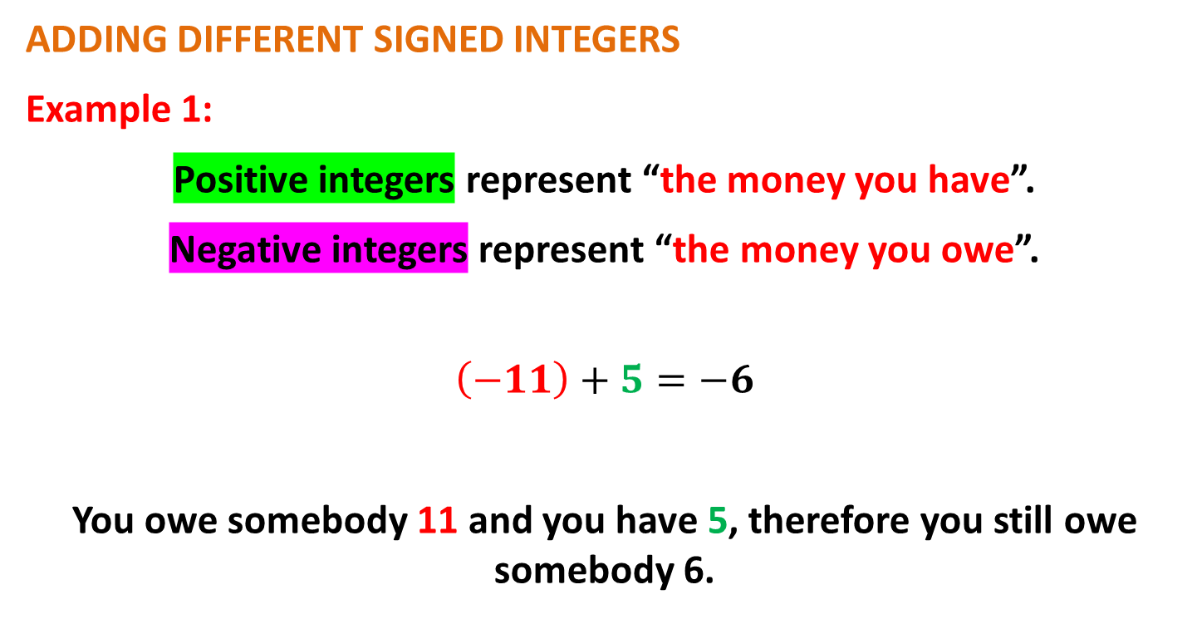
OPERATIONS ON INTEGERS
ADDING DIFFERENT SIGNED INTEGERS
Example 1:
Positive integers represent “the money you have”.
Negative integers represent “the money you owe”.
$$\left(−11\right)+5=−6$$
You owe somebody 11 and you have 5, therefore you still owe somebody 6.

Slide 30
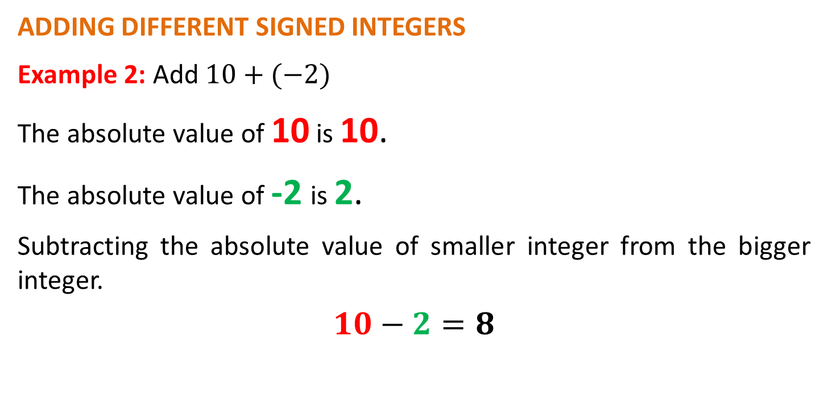
OPERATIONS ON INTEGERS
ADDING DIFFERENT SIGNED INTEGERS
Example 2: Add $10+(−2)$
The absolute value of 10 is 10.
The absolute value of -2 is 2.
Subtracting the absolute value of smaller integer from the bigger integer.
$$10−2=8$$

Slide 31
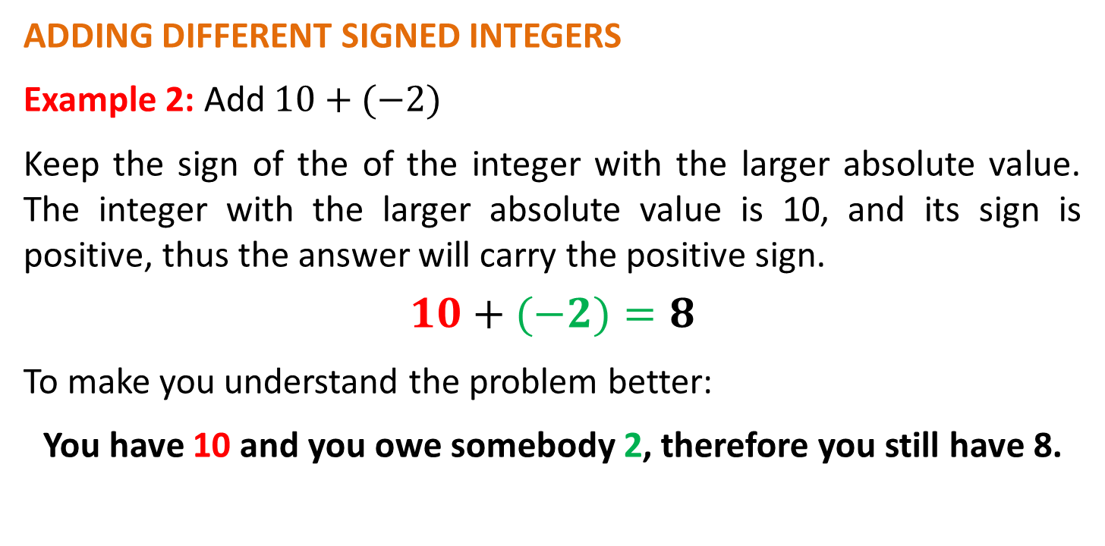
OPERATIONS ON INTEGERS
ADDING DIFFERENT SIGNED INTEGERS
Example 2: Add $10+(−2)$
Keep the sign of the of the integer with the larger absolute value. The integer with the larger absolute value is 10, and its sign is positive, thus the answer will carry the positive sign.
$$10+(−2)=8$$
To make you understand the problem better:
You have 10 and you owe somebody 2, therefore you still have 8.

Slide 32
OPERATIONS ON INTEGERS
ADDING DIFFERENT SIGNED INTEGERS
More Examples:

Slide 33
OPERATIONS ON INTEGERS
Sample Problem 2: Perform the indicated operation.

Slide 34
OPERATIONS ON INTEGERS
Sample Problem 2: Solution

Slide 35
OPERATIONS ON INTEGERS
SUBTRACTING INTEGERS NUMERICALLY
Just like adding integers numerically, subtracting integers also follow specific steps. These include the following:
Step 1: Copy the first number.
Step 2: Change subtraction into addition.
Step 3: Change the second number into its opposite.
Step 4: Apply the rules in adding integers.

Slide 36

OPERATIONS ON INTEGERS
SUBTRACTING SAME SIGNED INTEGERS
Example 1: $5−10$
The expression is read as “positive five minus positive ten”.

Slide 37

OPERATIONS ON INTEGERS
SUBTRACTING SAME SIGNED INTEGERS
Example 2: $−8−(−12)$
The expression is read as “negative eight minus negative twelve”.

Slide 38

OPERATIONS ON INTEGERS
SUBTRACTING DIFFERENT SIGNED INTEGERS
Example 1: $−11−20$
The expression is read as “negative eleven minus positive twenty”.

Slide 39

OPERATIONS ON INTEGERS
SUBTRACTING DIFFERENT SIGNED INTEGERS
Example 2: $7−(−17)$
The expression is read as “positive seven minus negative seventeen”.

Slide 40
OPERATIONS ON INTEGERS
SUBTRACTING DIFFERENT SIGNED INTEGERS
More Examples:

Slide 41
OPERATIONS ON INTEGERS
Sample Problem 3: Perform the indicated operation.

Slide 42
OPERATIONS ON INTEGERS
Sample Problem 3: Solution

Slide 43
OPERATIONS ON INTEGERS
MULTIPLYING INTEGERS NUMERICALLY
The rules in multiplying integers is less complicated compared to adding and subtracting integers. Below are the rules.
Rule 1: The product of multiplying integers with the
same signs is always POSITIVE.
Rule 2: The product of multiplying integers with
different signs is always NEGATIVE.

Slide 44
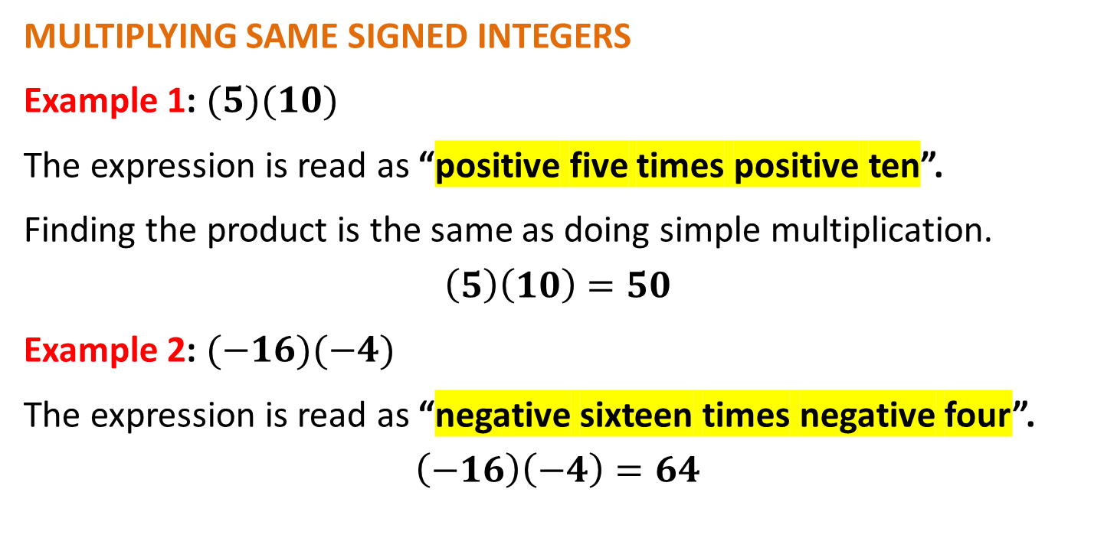
OPERATIONS ON INTEGERS
MULTIPLYING SAME SIGNED INTEGERS
Example 1: $(5)(10)$
The expression is read as “positive five times positive ten”.
Finding the product is the same as doing simple multiplication.
$$\left(5\right)\left(10\right)=50$$
Example 2: $(−16)(−4)$
The expression is read as “negative sixteen times negative four”.
$$\left(−16\right)\left(−4\right)=64$$

Slide 45
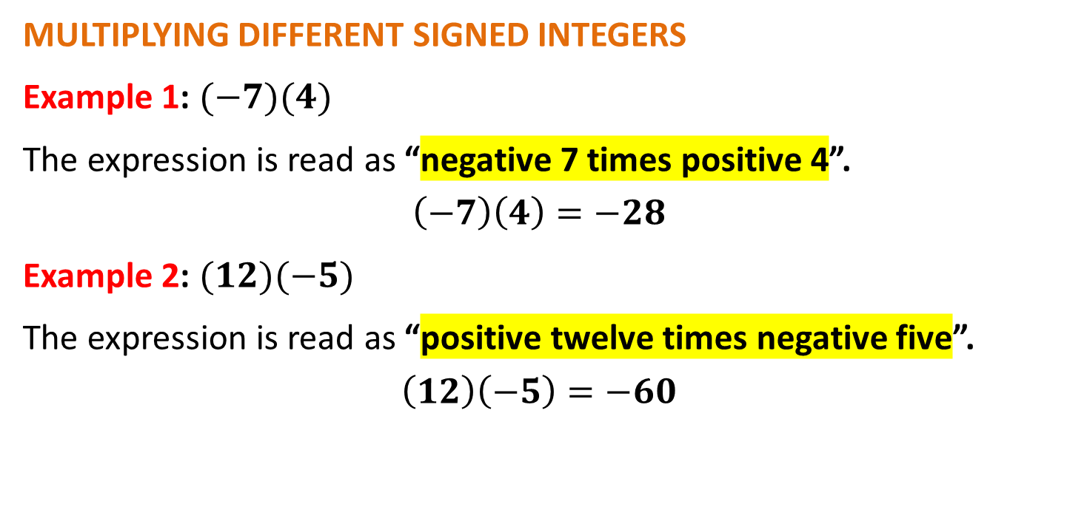
OPERATIONS ON INTEGERS
MULTIPLYING DIFFERENT SIGNED INTEGERS
Example 1: $(−7)(4)$
The expression is read as “negative 7 times positive 4”.
$$\left(−7\right)\left(4\right)=−28$$
Example 2: $(12)(−5)$
The expression is read as “positive twelve times negative five”.
$$\left(12\right)\left(−5\right)=−60$$

Slide 46
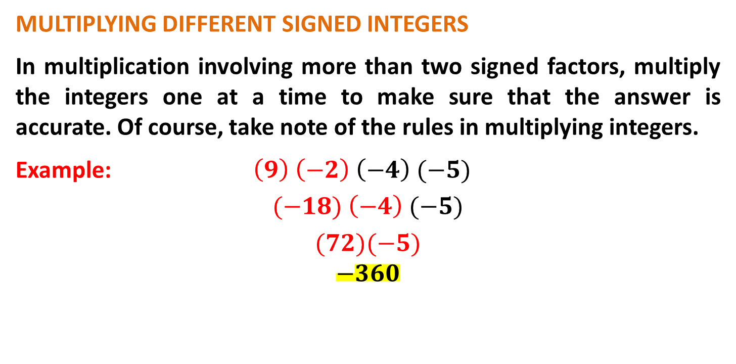
OPERATIONS ON INTEGERS
MULTIPLYING DIFFERENT SIGNED INTEGERS
In multiplication involving more than two signed factors, multiply the integers one at a time to make sure that the answer is accurate. Of course, take note of the rules in multiplying integers.
Example: $\left(9\right) \left(−2\right) \left(−4\right) (−5)$
$$(−18) \left(−4\right) (−5)$$
$$(72)(−5)$$
$$−360$$

Slide 47
OPERATIONS ON INTEGERS
MULTIPLYING DIFFERENT SIGNED INTEGERS
More Examples:

Slide 48
OPERATIONS ON INTEGERS
Sample Problem 4: Perform the indicated operation.

Slide 49
OPERATIONS ON INTEGERS
Sample Problem 4: Solution

Slide 50
OPERATIONS ON INTEGERS
DIVIDING INTEGERS NUMERICALLY
The rules in multiplying integers also work in dividing integers.
Rule 1: The quotient of dividing integers with the same signs is always POSITIVE.
Rule 2: The quotient of dividing integers with different signs is always NEGATIVE.

Slide 51
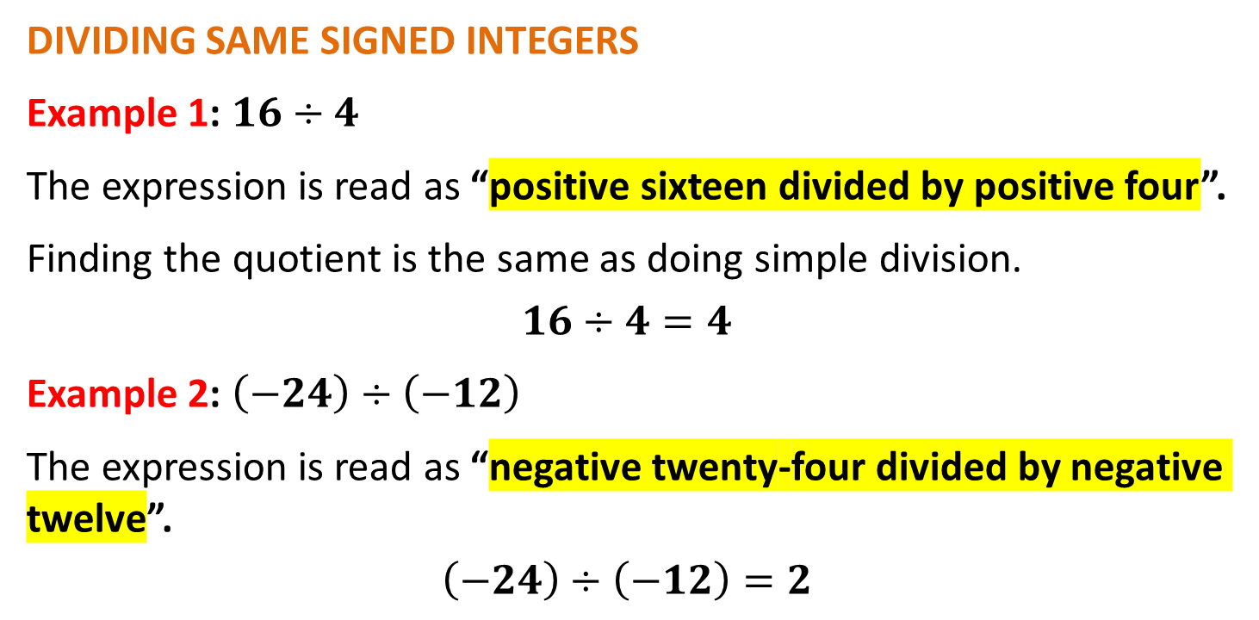
OPERATIONS ON INTEGERS
DIVIDING SAME SIGNED INTEGERS
Example 1: $16÷4$
The expression is read as “positive sixteen divided by positive four”.
Finding the quotient is the same as doing simple division.
$$16÷4=4$$
Example 2: $\left(−24\right)÷\left(−12\right)$
The expression is read as “negative twenty-four divided by negative twelve”.
$$\left(−24\right)÷\left(−12\right)=2$$

Slide 52
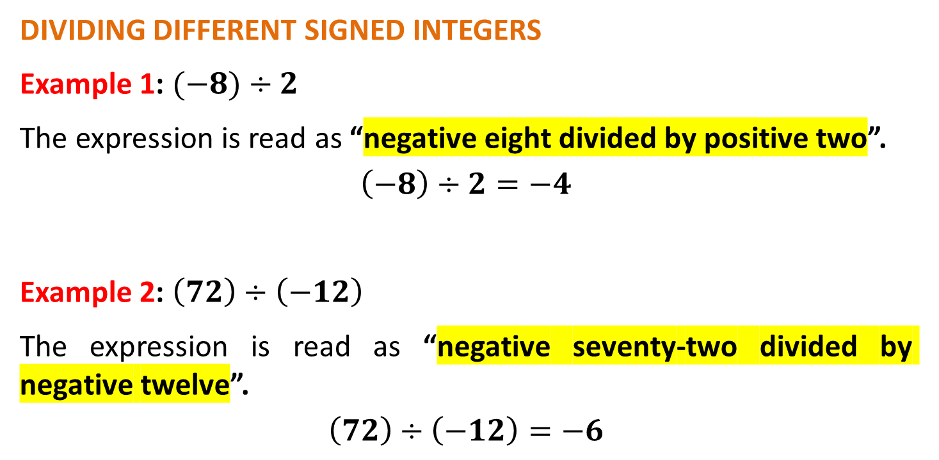
OPERATIONS ON INTEGERS
DIVIDING DIFFERENT SIGNED INTEGERS
Example 1: $(−8)÷2$
The expression is read as “negative eight divided by positive two”.
$$\left(−8\right)÷2=−4$$
Example 2: $\left(72\right)÷\left(−12\right)$
The expression is read as “negative seventy-two divided by negative twelve”.
$$\left(72\right)÷\left(−12\right)=−6$$

Slide 53
OPERATIONS ON INTEGERS
DIVIDING DIFFERENT SIGNED INTEGERS
More Examples:

Slide 54
OPERATIONS ON INTEGERS
Sample Problem 5: Perform the indicated operation.

Slide 55
OPERATIONS ON INTEGERS
Sample Problem 5: Solution

